Slide 1
Lecture 5: Interaction of x-rays with matters
Dr. Guohua Cao （曹国华）
caogh@shanghaitech.edu.cn
School of Biomedical Engineering
ShanghaiTech University
3/12/2024

Slide 2
Lecture 5: Interaction of x-rays with matters
X-ray as EM Radiation
EM Radiation
X-rays & Visible Lights
Energy Quanta of Photon
Atoms and Matters
Atoms in Human Body
Atomic Structure
X-ray Matter Interaction
Photoelectric Absorption
K-edge Absorption
Compton Scattering
Total X-ray Attenuation
NIST Database
Relative Contribution of Different Interactions
Beer’s Law and Attenuation Coefficients (Linear and Mass)
Dependence of X-ray attenuation on energy, beam hardening
Signal from X-ray Matter Interaction
Demo on Signal Processing

Slide 3
What is x-ray?
Electromagnetic radiation of high energy and very short wavelength (between ultraviolet light and gamma rays) that is able to pass through many materials opaque to light.

Slide 4
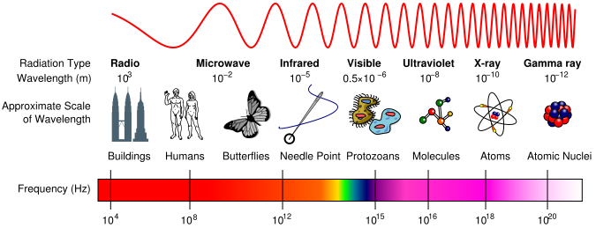
What is x-ray? (count.)
X-ray is EM (electromagnetic) radiations.
X-ray in medical imaging
20-120 kev
0.01-0.06 nm
10¹⁸-10¹⁹ Hz
X-ray Therapy 500 keV - Mega-ev
Notes:
Contrast arises from mainly diff. in photoelectric absorption.
Thus there is high contrast between hard and software tissues

Slide 5

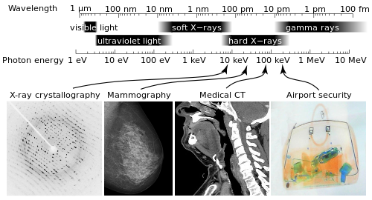
X-rays vs. visible lights
as lights, share some common properties of all lights
travel at the speed of light
wave–particle duality
common terms: spectrum, monochromatic, polychromatic, coherence, absorption, scattering, attenuation.
yet exhibit its unique properties
occupies a high-energy region
of the whole EM spectrum
highly energetic and
ionizing radiation with deep
penetration capability
Unique terms: photoelectric interaction, Compton scattering, K edge

Slide 6
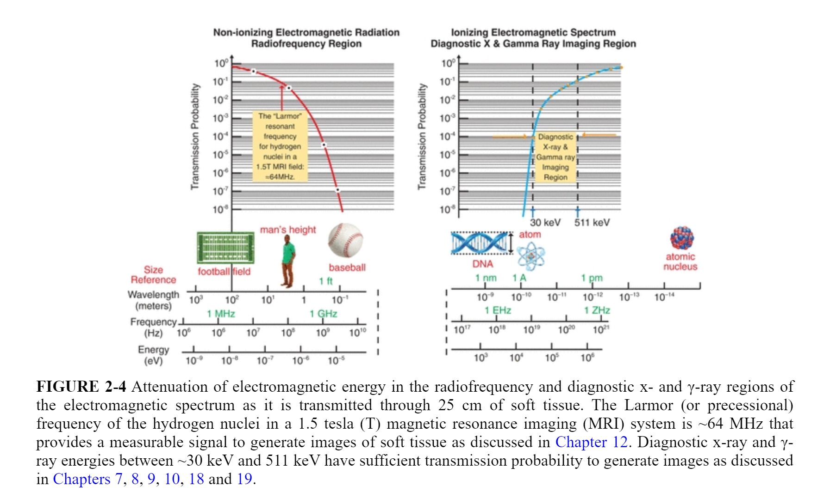
Transmission of EM Radiation

Slide 7



Photon and Energy Quanta
For all EM radiations,
frequency vs. wavelength
$$f=\frac{1}{T}, λ=cT→f=\frac{c}{λ}$$
energy vs. frequency
$$E=hf=ℏν$$
$$ν=2πf ℏ=h/2π$$
h is Planck constant
h=6.626 x 10⁻³⁴ J s
 | Frequency | Wavelength | Energy
 | Hz | m | eV
x-ray | 1.00E+19 | 3.00E-11 | 4.14E+04
soft x-ray | 1.00E+18 | 3.00E-10 | 4.14E+03
visible light | 1.00E+15 | 3.00E-07 | 4.14E+00
Terahertz | 1.00E+12 | 3.00E-04 | 4.14E-03
Gigahertz | 1.00E+09 | 3.00E-01 | 4.14E-06
RF - UHF | 3.00E+08 | 9.99E-01 | 1.24E-06
RF - VHF | 3.00E+07 | 9.99E+00 | 1.24E-07
RF - High Freq. | 3.00E+06 | 9.99E+01 | 1.24E-08
RF - Medium Freq. | 3.00E+05 | 9.99E+02 | 1.24E-09
1ev = 1.60e-19J
Notes:
The FM radio band is from 88 to 108 MHz in ~VHF.

Slide 8
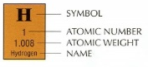
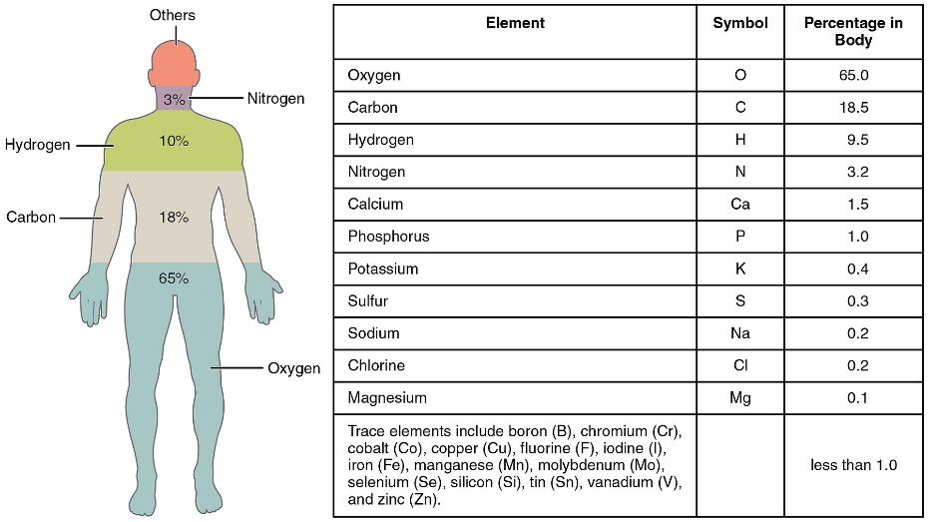

Atoms in Human Body
Element | Mass percent | Atomic percent | Electrons per shell | K shell binging energy (keV)
Hydrogen | 10 | 62 | K1 | 0.014
Oxygen | 65 | 24 | K2, L4 | 0.543
Carbon | 18 | 12 | K2, L6 | 0.284
Calcium | 1 | 0.22 | K2, L8, M8, N2 | 4.039
https://en.wikipedia.org/wiki/Composition_of_the_human_body

Slide 9
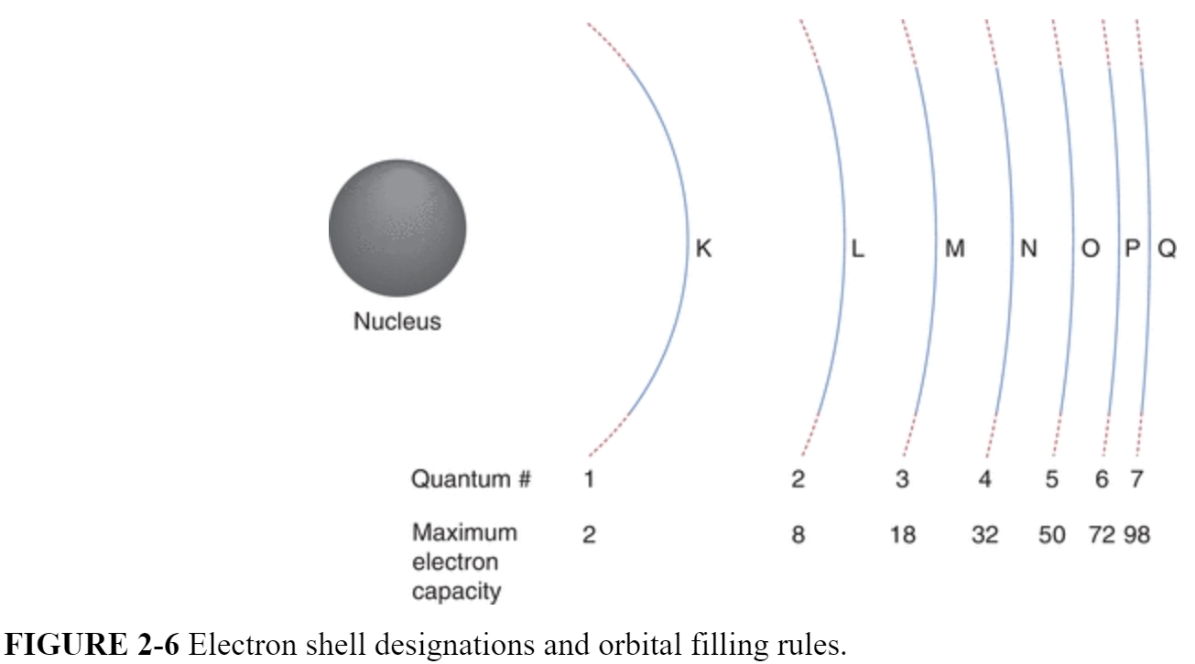
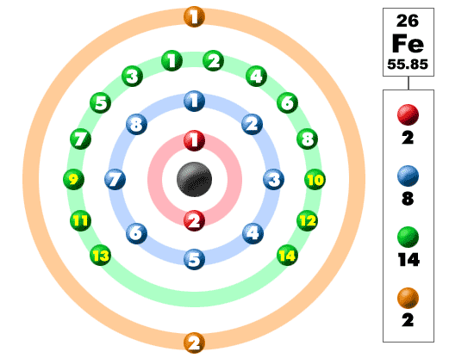
Structure of Atom
Fe: K2,L8,M14,N2
K
L
M
N

Slide 10
Photoelectric Absorption
Inner K shell electron gets knocked out to infinity by incident x-rays
Outer L shell electron migrates to the K shell vacancy.
A characteristic x-ray photon is emitted in the process.
In the process, total energy of the incident x-ray photon, ejected electron, and characteristic x-ray photon is absorbed.
The end is a bunch of ionized atoms and free electrons.

Slide 11
Photoelectric Absorption
In diagnostic x-ray energy range,
absorption ∝ Z³/E³
Energy dependence
→ Photoelectric absorption is dominant when x-ray energy is low.
Matter dependence
→ Lead (Z=82) is an excellent x-ray absorber and used for shielding x-rays.

Slide 12
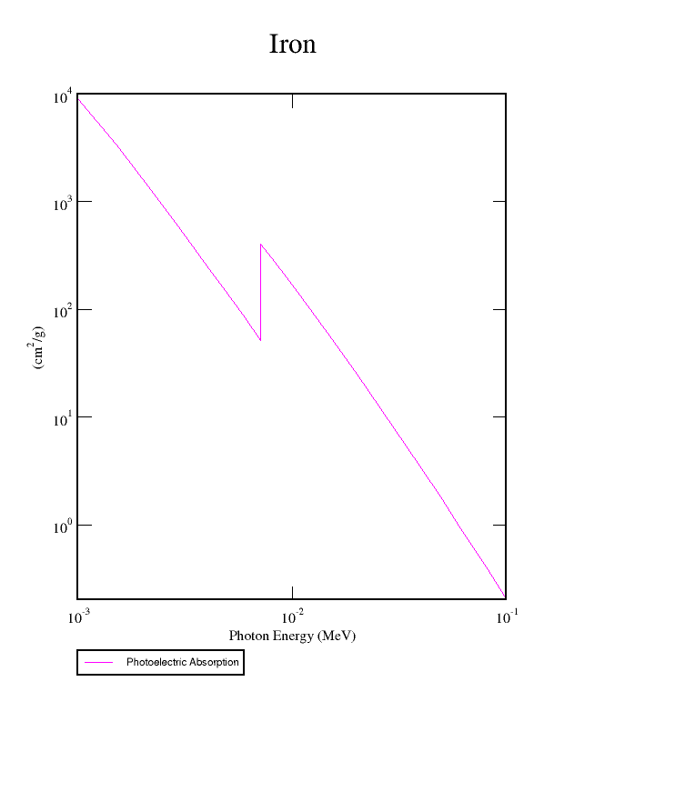
K-edge Absorption
Sudden increase of x-ray attenuation coefficient when incident x-ray photon energy is just above the K shell binding energy of the target atoms.
For K-edge absorption to occur, incident x-ray photons must have energy greater than the k-edge energy of the target atom.
Notes:
Introduce K edge imaging

Slide 13
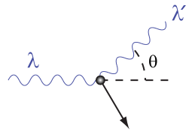
Compton Scattering
An incoming photon with wavelength λ collides with an loosely bounded outer shell electron that is treated as being at rest.
The incoming photon transfers part of its energy to the electron, causing the electron to eject.
The scattered photon has less energy than the incoming photon, or has longer wavelength λ’ (> λ), to conserve energy.
The scattered photon exits at a certain angle θ to the forward direction, to conserve momentum.

Slide 14
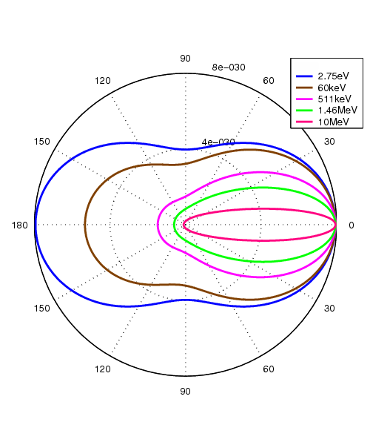
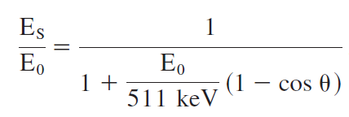
Compton Scattering
Scattering probability is not same at every angle.
Energy of Compton scattered photons
511keV is the energy equal to the rest mass of the electron.
Klein–Nishina distribution of scattering-angle cross sections over a range of commonly encountered energies.

Slide 15
Total x-ray attenuation
In optics:
Total attenuation = absorption + scattering
Equivalently, in x-ray imaging:
Total x-ray attenuation = photoelectric absorption + scattering

Slide 16
Relative contributions
Figure shows the relative contributions of photoelectric absorption and Compton scattering to the total attenuation coefficient of water.
Photoelectric absorption dominates at the low energy while Compton scattering dominates at high energy.
Photoelectric absorption dominates
Compton scattering dominates

Slide 17
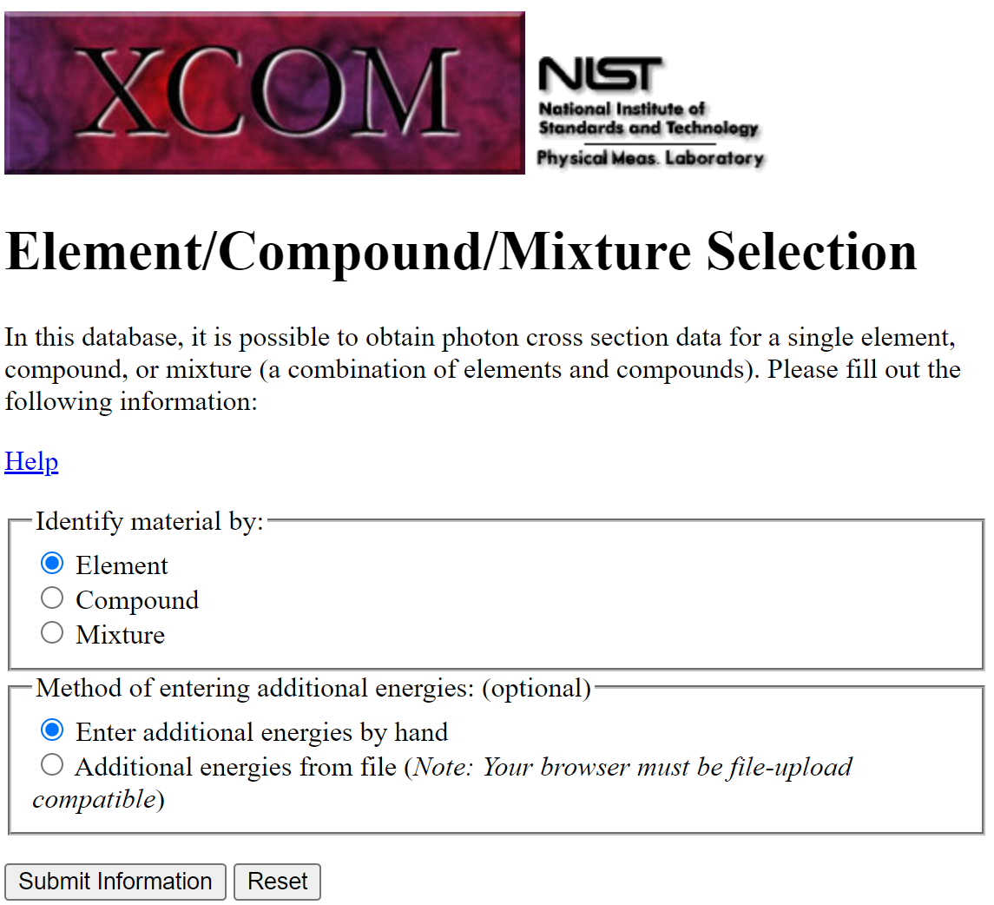
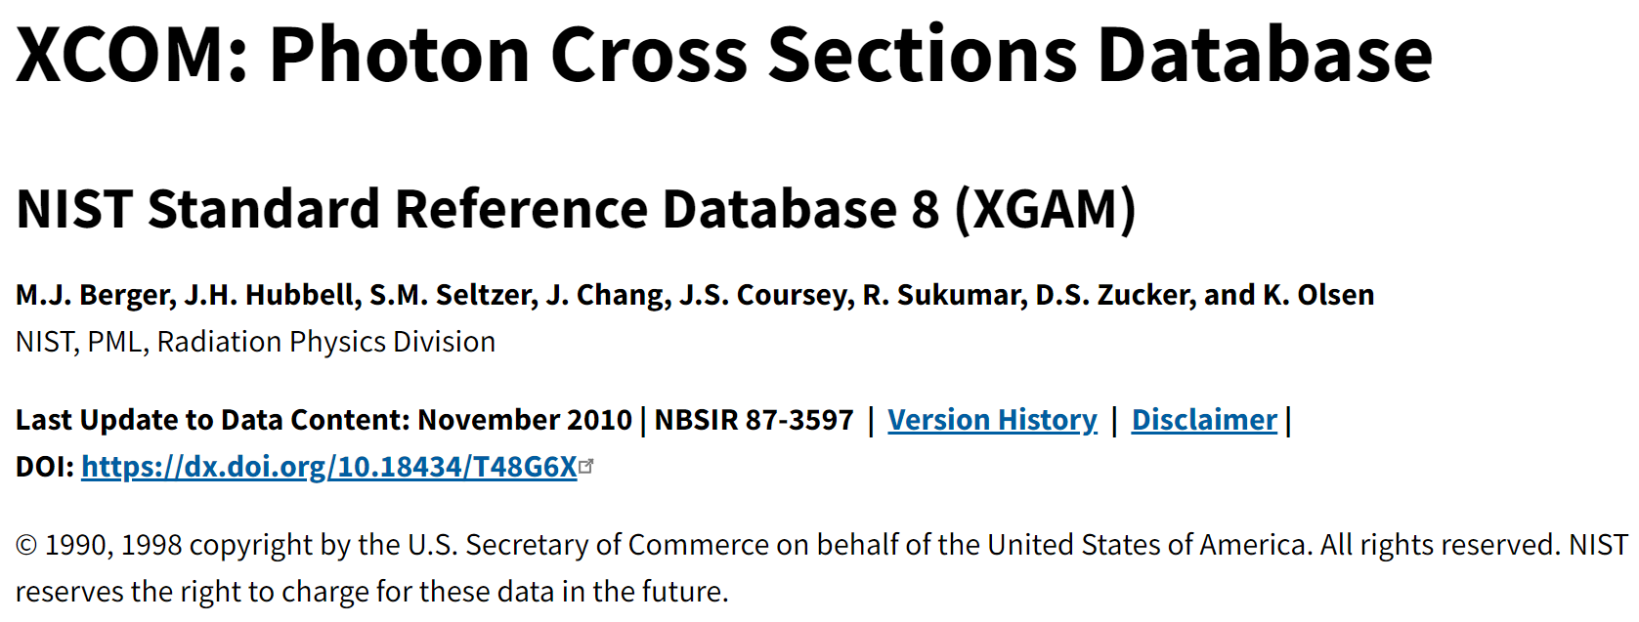
NIST Database
https://physics.nist.gov/PhysRefData/Xcom/html/xcom1.html

Slide 18
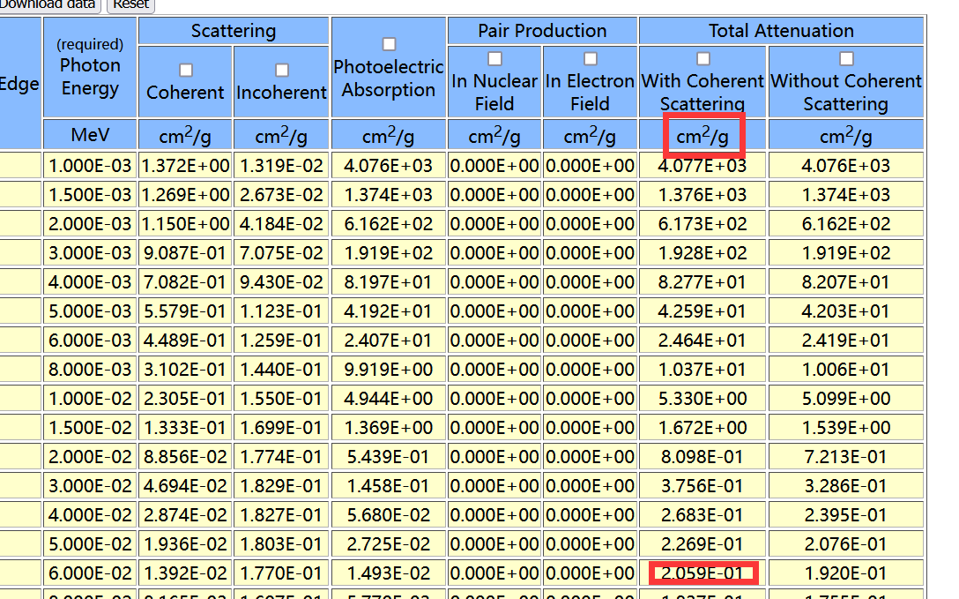
NIST: X-ray reference
https://physics.nist.gov/PhysRefData/Xcom/html/xcom1.html

Slide 19
Beer’s law & X-ray linear attenuation coefficient
Beer-Lambert law

Slide 20
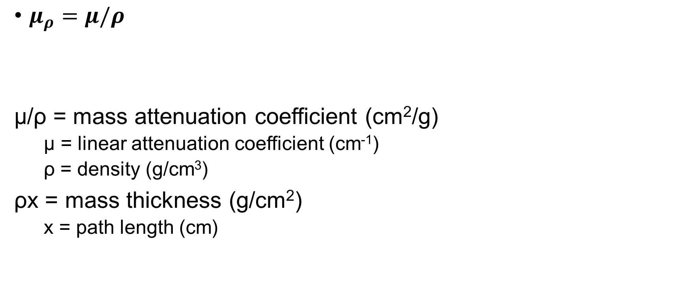
Mass Attenuation Coefficient
$μ_{ρ}=μ/ρ$
μ/ρ = mass attenuation coefficient (cm²/g)
μ = linear attenuation coefficient (cm⁻¹)
ρ = density (g/cm³)
ρx = mass thickness (g/cm²)
x = path length (cm)

Slide 21
X-ray attenuation of various tissues
Energy dependence of the linear attenuation coefficient:
linear attenuation coefficient is higher at lower x-ray energy, and lower at higher x-ray energy.
Notes:
Note Bone vs fat & muscle; muscle vs fat in x-ray contrast.

Slide 22
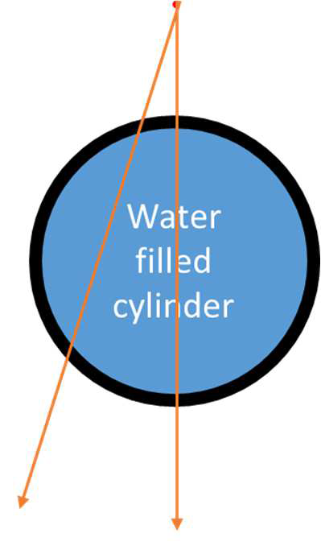
X-ray Beam Hardening
A
original
B
C
Energy dependence of the linear attenuation coefficient: linear attenuation coefficient is higher at lower x-ray energy and lower at higher x-ray energy.

Slide 23
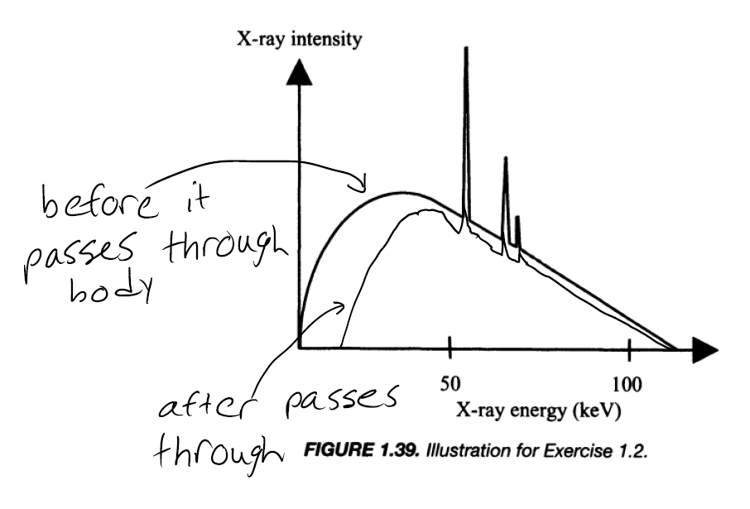
Beam Hardening
Average energy becomes higher, that is, hardened.

Slide 24
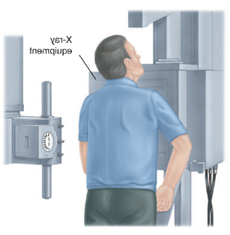
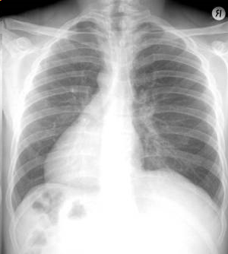

Signal from X-ray Matter Interaction
X-ray Detector
Object
I₀
μ₁
μ₂
μ₃
μ_{N}
I
…
X-ray Source
Notes:
Before we move onto explaining how CT works, let’s first take a look at the conventional 2D radiography.
In conventional 2D radiography, such as chest x-ray imaging, a patient stands between an x-ray source and an detector. During image acquisition, nothing rotates. After a short x-ray exposure, the transmitted x-ray intensity after the object is recorded into a 2D radiograph image, in this case a chest x-ray image, is formed. An example chest x-ray image is shown in the right.
(click)
In conventional radiography, the 3D volume of a human body is compressed along the x-ray direction to a 2D image, therefore it does not have the ability to resolve overlapping tissues.

Slide 25
What signals do we measure?
I₀
μ₁
μ₂
μ₃
μ_{N}
I
…
Δx
S = logI₀/I= Δx∑μ_{i}
→ S=Total attenuation in the x-ray path length
I, I₀ are the raw data measured by the detector.
S is the signal pre-processed from the raw data I, I₀.
Notes:
Unlike 2D radiography, CT is a 3D modality. It can resolve the local contrast even within a very thin slice. So, how a CT works?
In CT, an object is also positioned between an x-ray source and detector. And we also measure the transmitted x-ray intensity after the object. The differences are mainly in two parts: (1). In addition to the transmitted x-ray intensity after the object, we also measure the x-ray intensity before the object. (click) With both intensity measurements, we can derive the signals during CT data acquisition following the Beer’s Law. The signal essentially is the integration of attenuation along the x-ray beam path. (2) (Click) The 2nd difference is for CT we need do rotation and sample the signals from many view angles. The reason for this is closely related to how we reconstruct CT images. Let’s use this simple 4-voxel slice as an example. In this slice, there are four voxel of same dimensions but different attenuation coefficients. If we sample this slice with x-ray from left to right, we got two signals (S1 & S2) from two line integrals, and we have 2 equations. But 2 equations are not sufficient for solving the 4 unknown attenuation coefficients. If we sample this slice with x-ray from another direction, top-to-bottom, we will receive 2 more signals (S3 & S4) from another two line integrals, and we have another 2 equations. Now we have a total of 4 equations. With these 4 equations we can find the 4 unknown attenuation coefficients.

Slide 26
Matlab Demo
imread()
imagesc()
image matrix operations
Correction for detector offset
S=log(I0/I)
Plot line intensity profile
Crop the image

Slide 27
X=imread(‘1.tif’);
imagesc(X);
colormap gray
imagesc(X, [100,2000]);
Offset=imread(‘dark.tif’);
X=X-Offset
Y=imread(‘blank.tif’);
/* convert matrices to double float format for matrix division */
X=double(X);
Y=double(Y);
/* signal */
S=log(Y./X);

